Slide 1


Minor Project - 2
Title:
“Stock Market Prediction Using Machine Learning Approach”
Presented By:
Name - Aryan Udainiya SAP ID - 500083145
Name - Peeyush Pal Singh SAP ID - 500083838
Name - Pulkit Bhatia SAP ID - 500082315
Name - Rakshit Partap Singh SAP ID - 500083018
Guided By: Mrs. Bhavana Kaushik

Slide 2
CONTENT
Introduction
Problem Statement
Area of Application
Motivation
Objectives
SWOT Analysis
Methodology
Pert Chart
Working Model & Results
References

Slide 3
INTRODUCTION
In today's time many people are interested in investing money in stock market to earn more in less time.
Here, the stock market consists of a number of company shares along with the prices in the stock market, the share price will change every minute depending on the company's environment and the country's economic structure decisions. There are many brokers in the stock market to buy and sell stocks between the customers and the company. In previous years it is difficult to predict share market because there is lack of technology and knowledge but in present days technology is increasing day by day so we can predict share market easily when we compare in past Here we can predict the share price by analyzing the past. data using machine learning techniques. From these techniques we can use neural network (means it is connected networking, it looks like human neural brain structure) and simple moving average method.[1]

Slide 4
PROBLEM STATEMENT
The stock market appears in the news every day. You hear about it every time it reaches a new high or a new low.
The rate of investment and business opportunities in the Stock market can increase if an efficient algorithm could
be devised to predict the short-term price of an individual stock.[2]
AREA OF APPLICATION
The area of application of machine learning in stock market prediction is to use:
Regression models: Linear regression or polynomial regression models can be used to predict future stock prices
based on historical data. These models use features such as past prices, trading volume, and economic indicators
to make predictions.[3]
Sentiment analysis: Machine learning models can be used to analyze news articles, social media posts, and other
sources of market sentiment to gauge investor sentiment and make predictions about future stock prices.
Pattern recognition: Machine learning algorithms such as decision trees, random forests, and neural networks
can be used to identify patterns in stock market data and make predictions based on those patterns.[4]

Slide 5
MOTIVATION
There are several motivations for using machine learning in stock market prediction:
Increased accuracy: Machine learning models can analyze large amounts of data and identify patterns that may be difficult for humans to detect. This can lead to more accurate predictions of stock prices and market trends.[5]
Improved efficiency: Machine learning algorithms can process and analyze data much faster than humans, which can help investors make more informed decisions in a timely manner.
Better risk management: Accurate predictions can help investors better manage their risks by identifying potential market downturns and adjusting their investment strategies accordingly.[6]
Access to new data sources: Machine learning models can be used to analyze a wide range of data sources, including social media, news articles, and economic indicators. This can provide investors with new insights into market trends and sentiment.
Competitive advantage: Using machine learning to predict stock prices can give investors a competitive advantage over those who rely solely on traditional methods of analysis.[7]

Slide 6
OBJECTIVE
Stock market prediction using Deep Learning is done for the purpose of turning a profit by analyzing and extracting information from historical stock market data to predict the future value of stocks. One of the main aims of a trader is to predict the stock price such that we can sell it before its value decline, or buy the stock before the price rises. The efficient market hypothesis states that it is not possible to predict stock prices and that stock behaves in the random walk.[8]

Slide 7
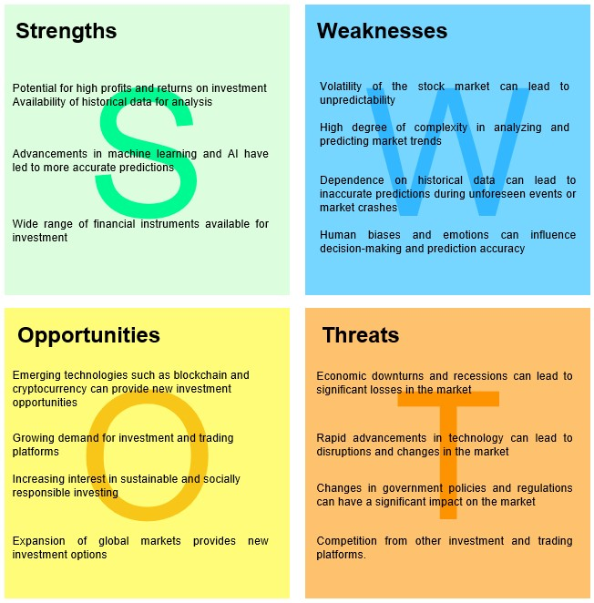
SWOT ANALYSIS

Slide 8
CHANGES DONE AFTER MID-TERM PRESENTATION
Following our mid-term presentation, we have integrated three machine learning models onto our platform:
The three models we have uploaded are Random Forest, SVM, and LSTM neural networks.
These models have been specifically trained on our reliance data set for accurate stock price prediction.
With these models, we are well-equipped to provide our users with reliable and insightful predictions for Reliance stock prices.

Slide 9
METHODOLOGY
The methodology for stock market prediction using linear regression, random forest, SVM, and LSTM models involves collecting and preprocessing historical stock market data, followed by feature engineering to extract relevant features. The data is then split into training and testing sets, and the models are trained using the training set. After training, the models are evaluated using various statistical validation metrics such as RMSE, R-squared, and confusion matrices. Once the models are validated, they can be used for predicting future stock prices or trends. Each model has its own strengths and weaknesses, and the choice of model depends on the nature of the data and the specific goals of the analysis.

Slide 10
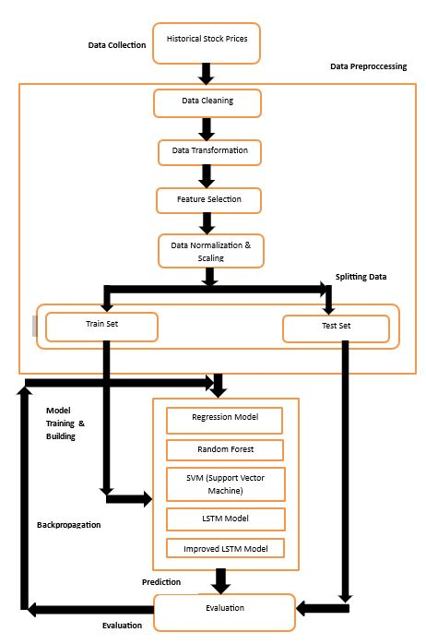
Fig - 1: METHODOLOGY FLOW CHART

Slide 11
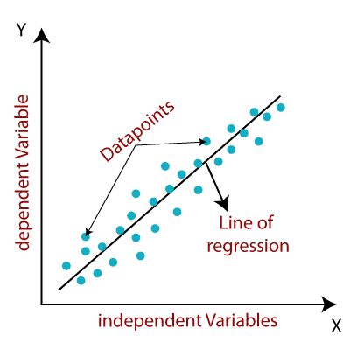
ARCHITECTURE OF LINEAR REGRESSION
FORMULA : y = mx + b
y = dependent variable
x = independent variable
m = slope of the line
b = y-intercept
Fig - 2: ARCHITECTURE OF LINEAR REGRESSION

Slide 12
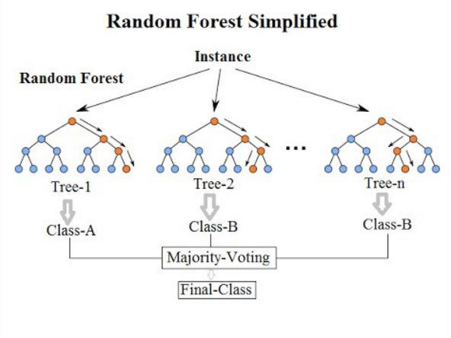
ARCHITECTURE OF RANDOM FOREST CLASSIFIER
FORMULA:
Prediction = 1/N * (Prediction from Tree 1 + Prediction from Tree 2 + ... + Prediction from Tree N)
N = number of decision trees in the forest
Fig - 3: ARCHITECTURE OF RANDOM FOREST CLASSIFIER

Slide 13
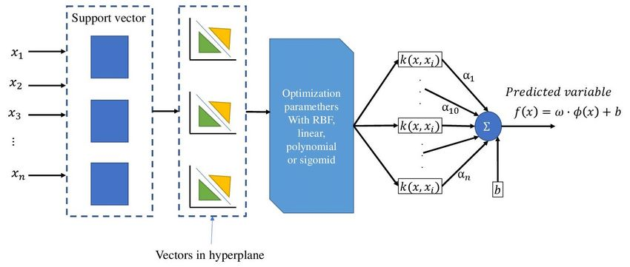
ARCHITECTURE OF SVM(SUPPORT VECTOR MACHINE)
FORMULA:
hyperplane in an SVM is, w*x + b = 0
w = weight vector
x = input vector
b = bias term.
Fig - 4: ARCHITECTURE OF SVM(SUPPORT VECTOR MACHINE

Slide 14
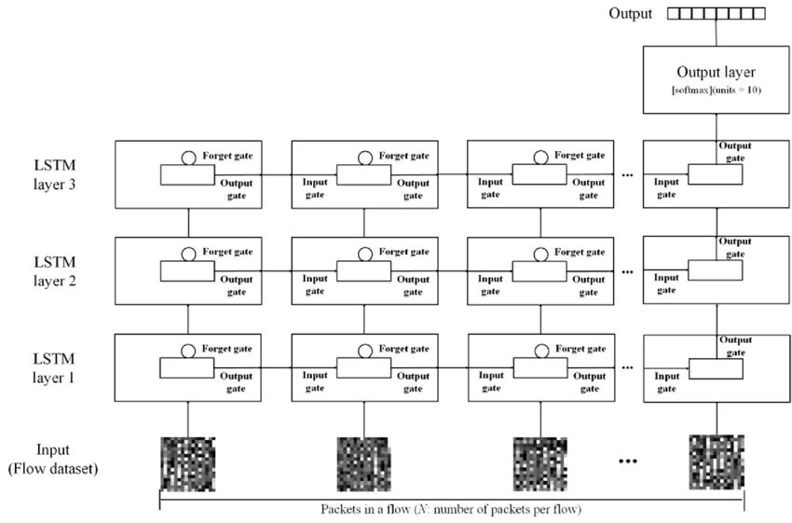
ARCHITECTURE OF LSTM(LONG-SHORT TERM MEMORY)
Input Gate: i_t = σ(W_i * [h_{t-1}, x_t] + b_i)
Forget Gate: f_t = σ(W_f * [h_{t-1}, x_t] + b_f)
Output Gate: o_t = σ(W_o * [h_{t-1}, x_t] + b_o)
Fig - 5: ARCHITECTURE OF LSTM(LONG-SHORT TERM MEMORY)

Slide 15
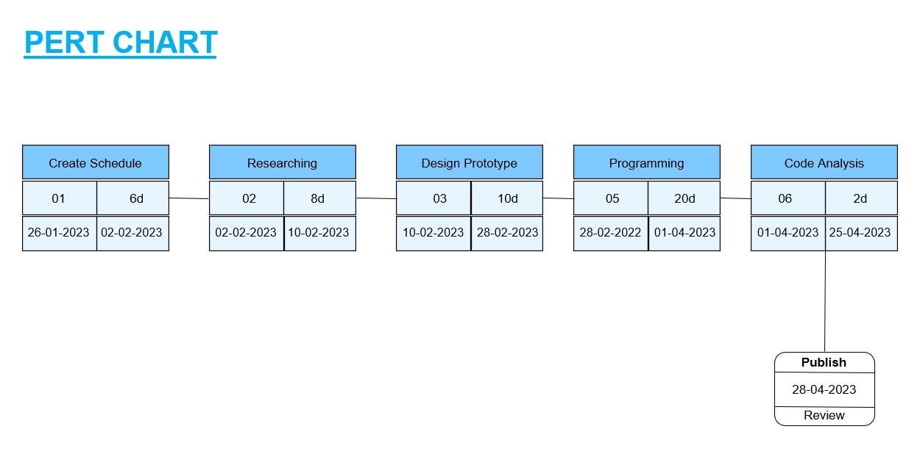
Fig-6: PERT CHART

Slide 16
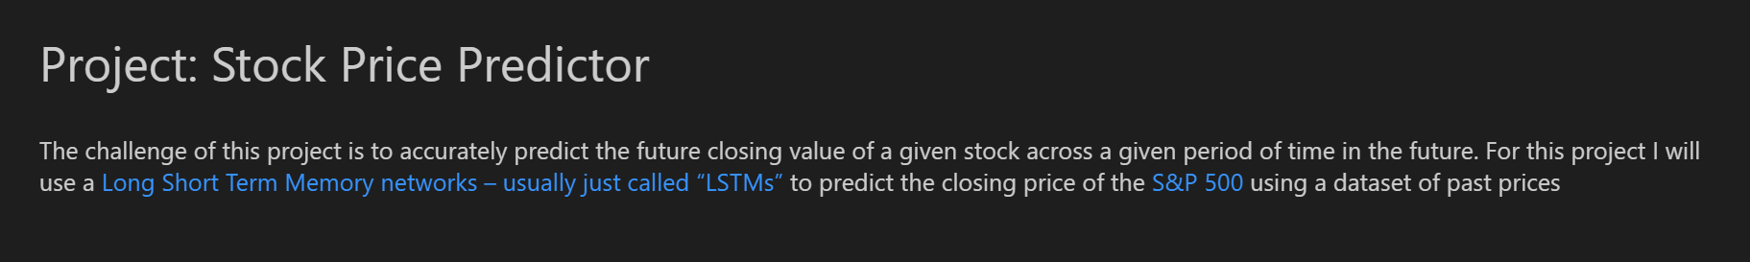
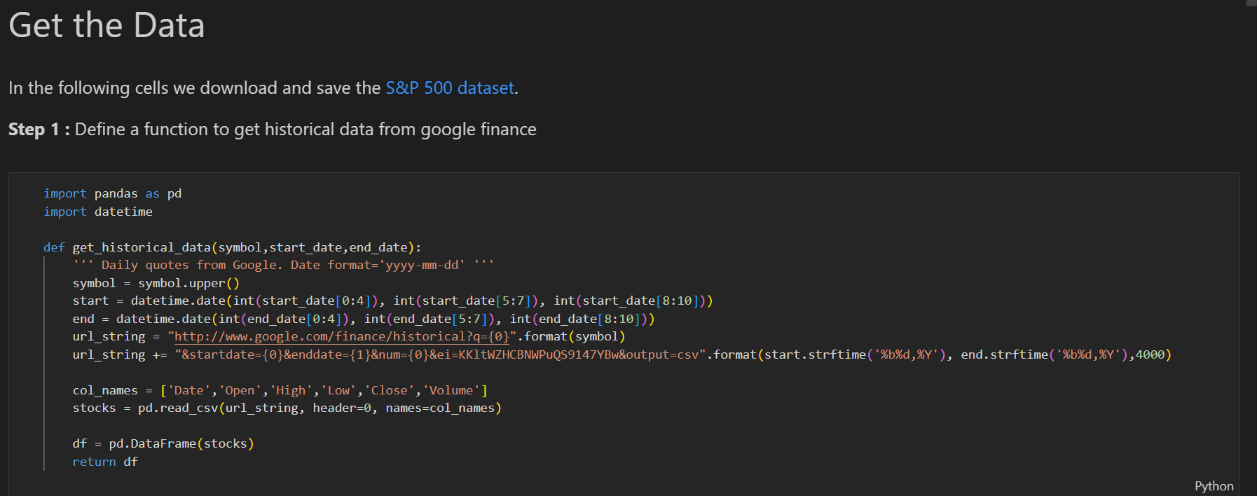
WORKING MODEL

Slide 17
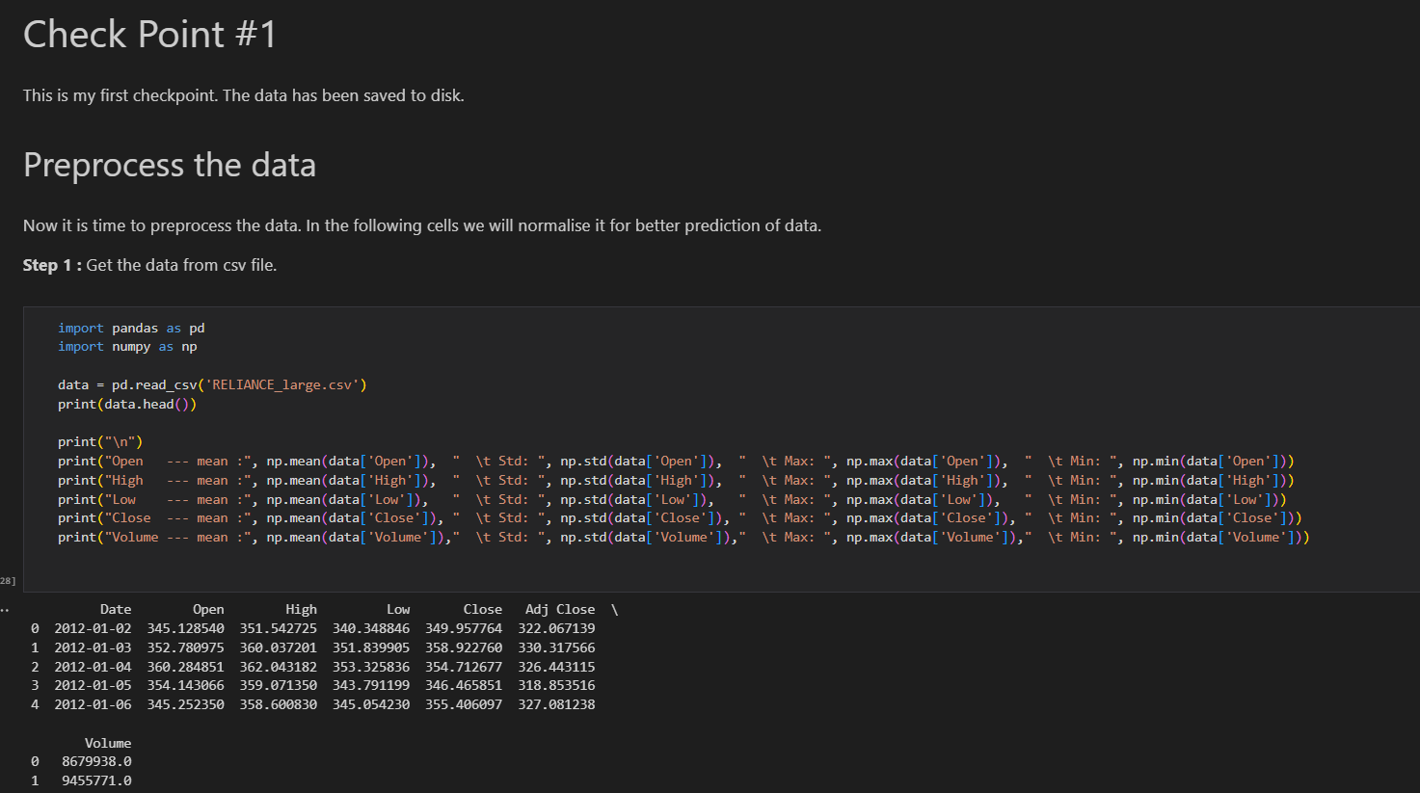
Here we Have Performed the Pre-Processing of the Data

Slide 18
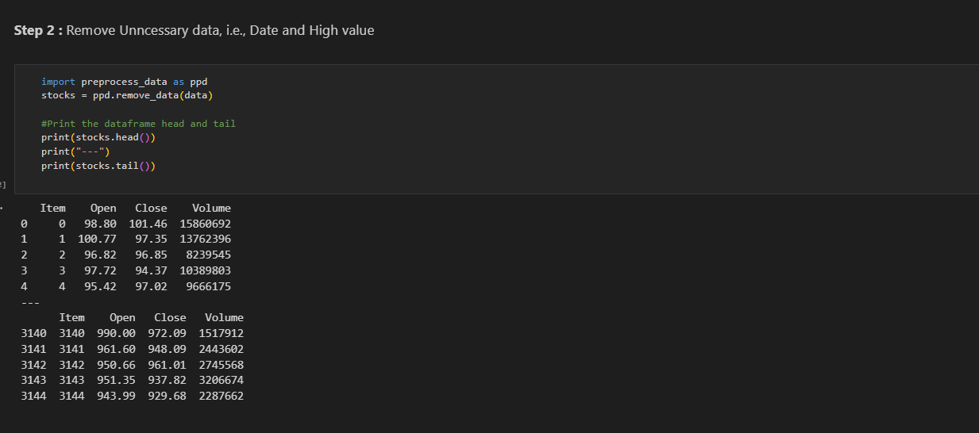
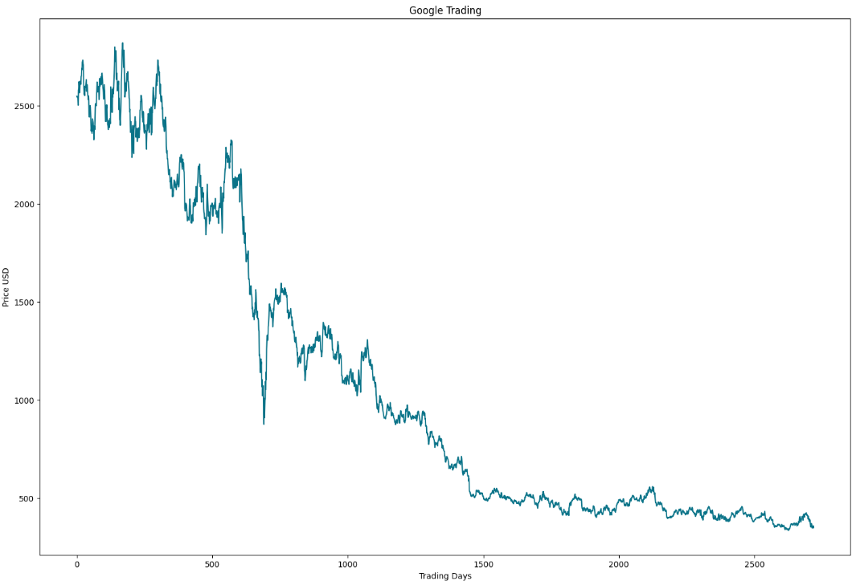
REMOVE UNNECESSARY DATA FROM OUR DATASET
VISUALIZING THE RAW DATA

Slide 19
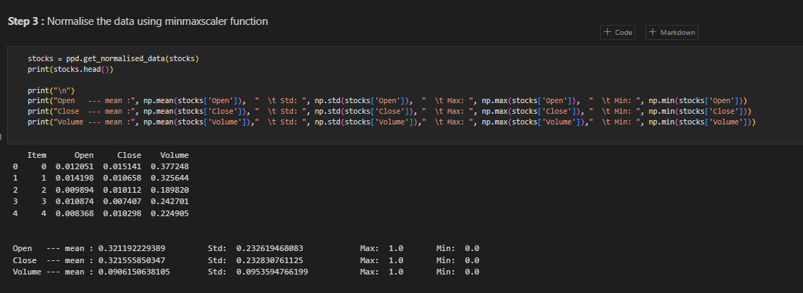
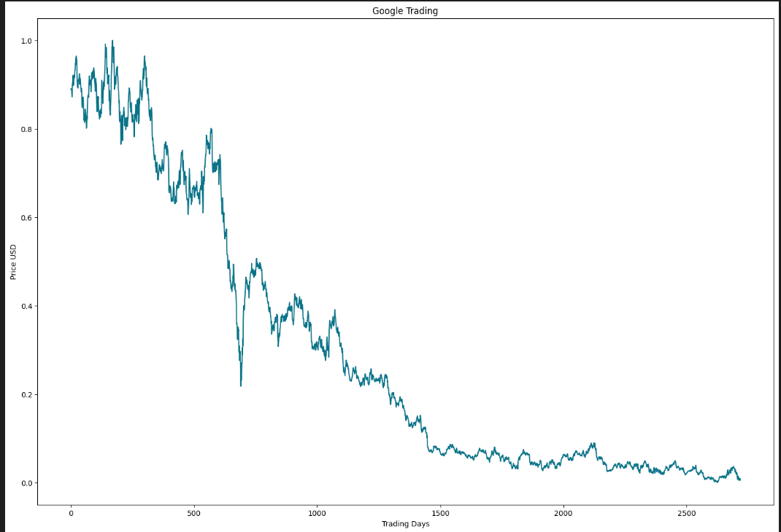
NORMALIZE THE DATA USING MIN MAX SCALER FUNCTION
VISUALIZE THE DATA AGAIN

Slide 20
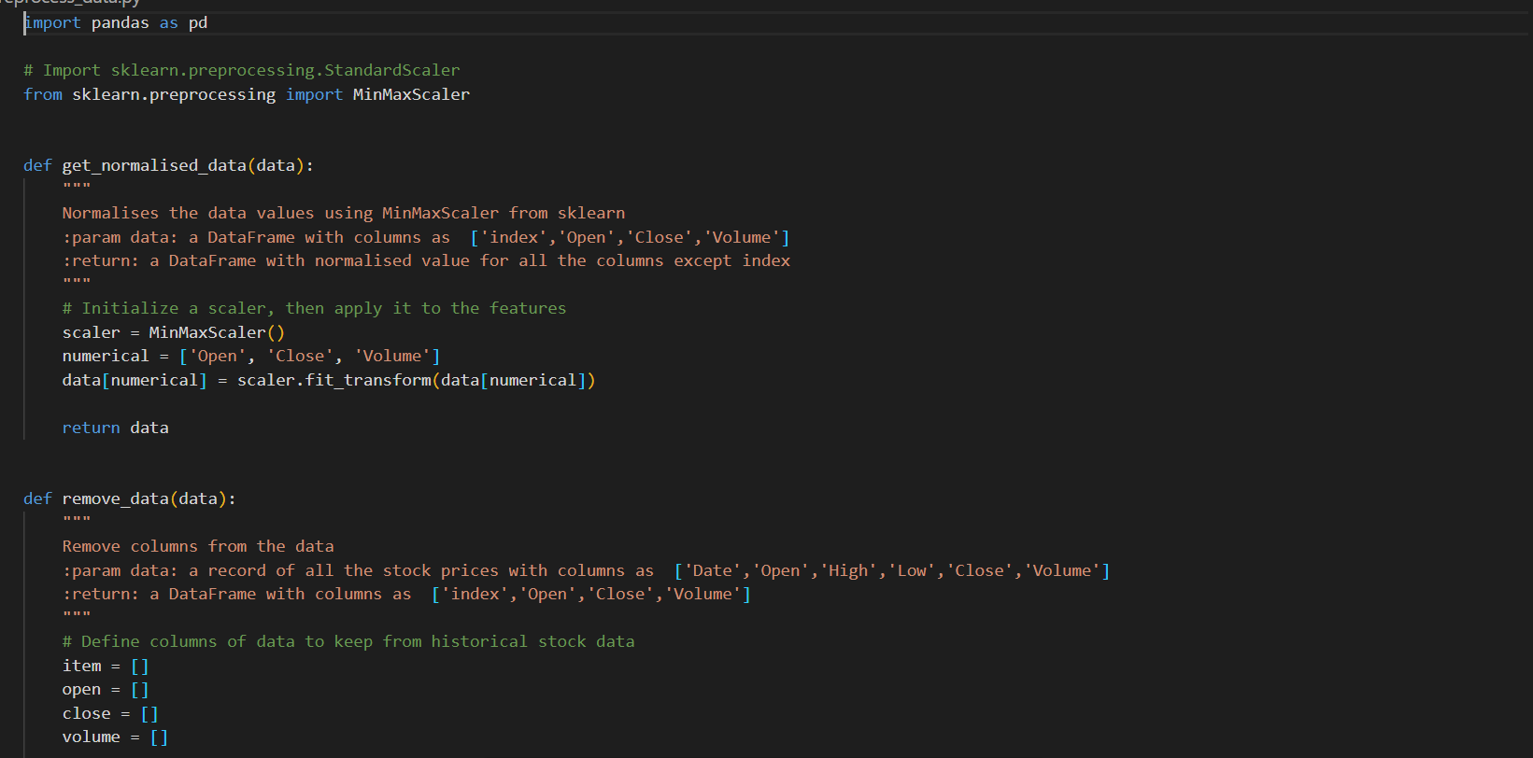
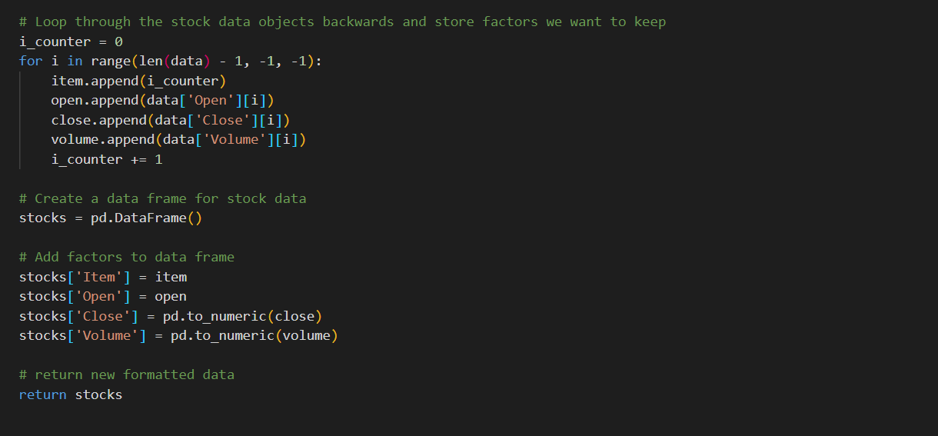
PRE-PROCESSED FILE

Slide 21
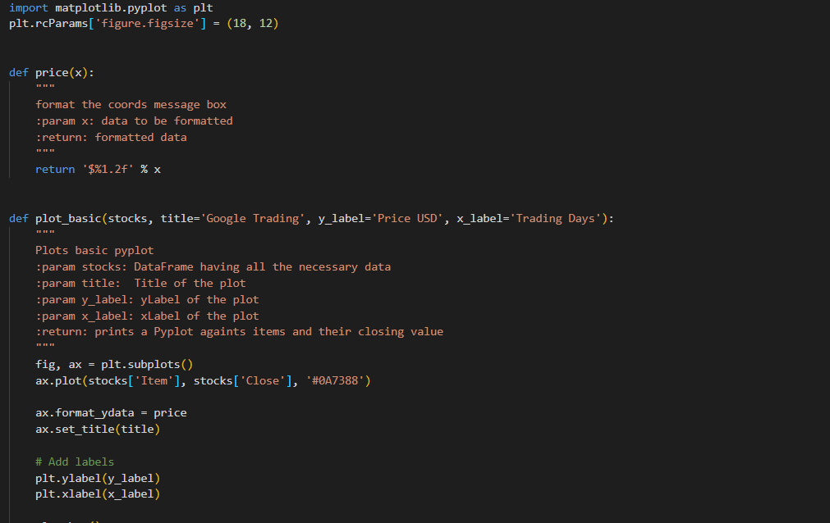
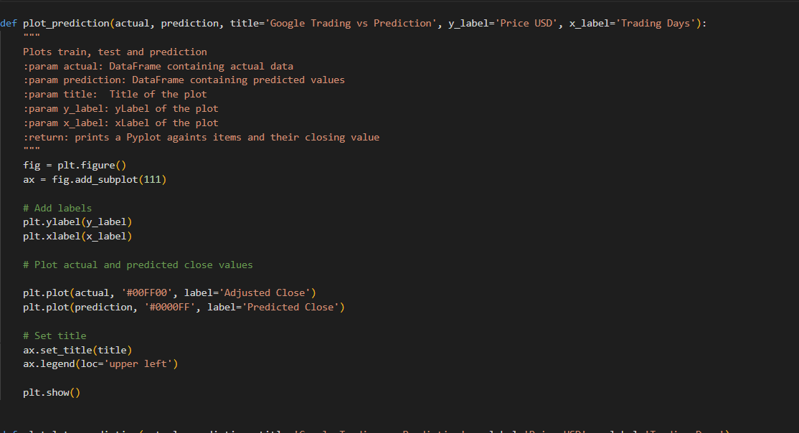
Visualize File

Slide 22
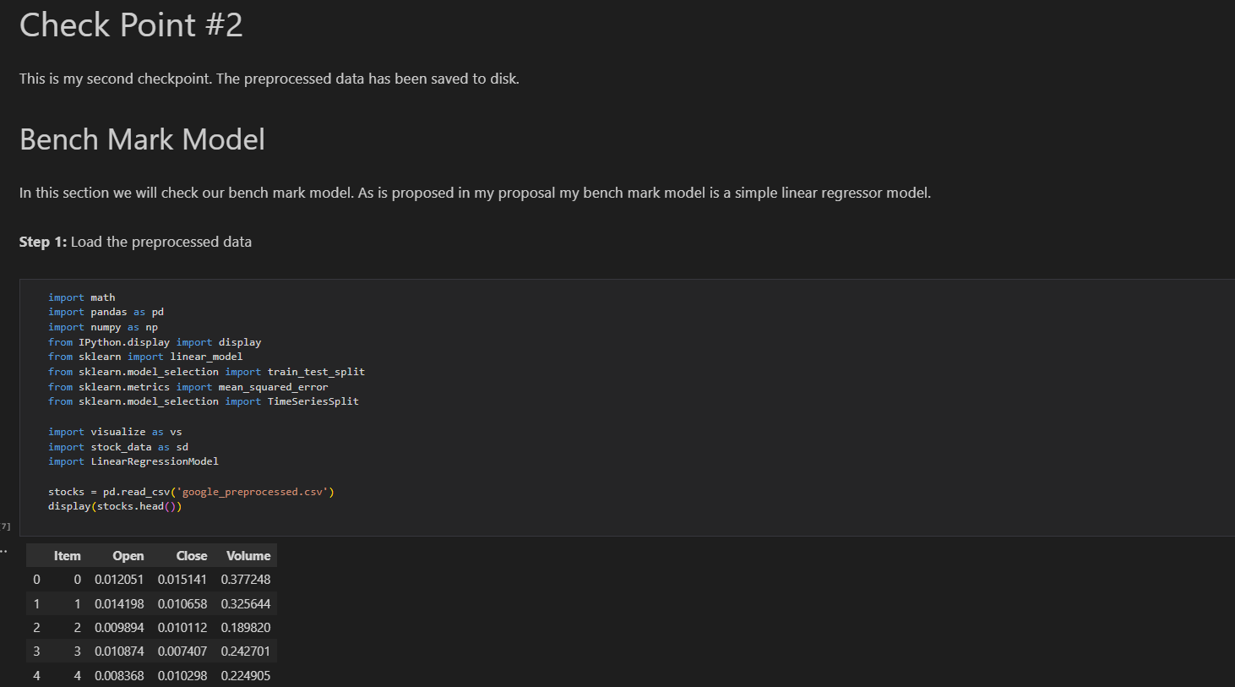
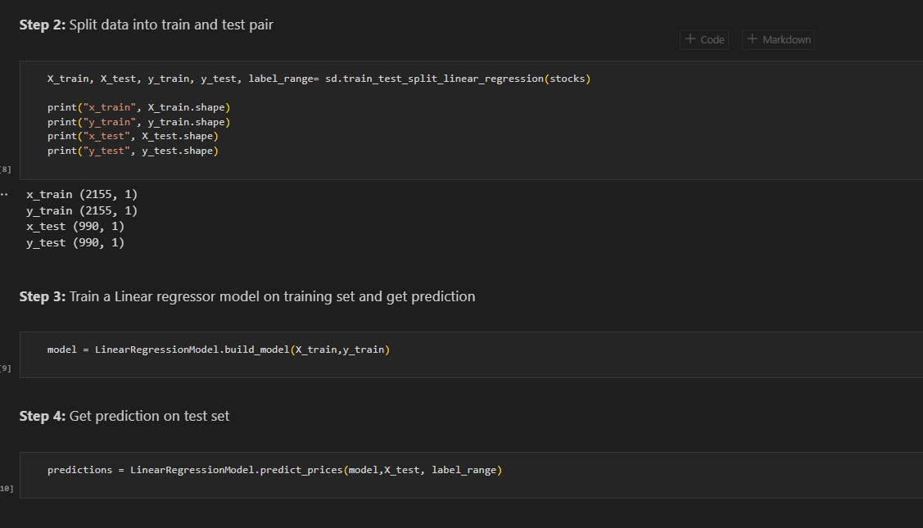
HERE WE ARE DEPLOYING OUR REGRESSION MODEL
SPLITTING INTO TRAINING AND TESTING DATA

Slide 23
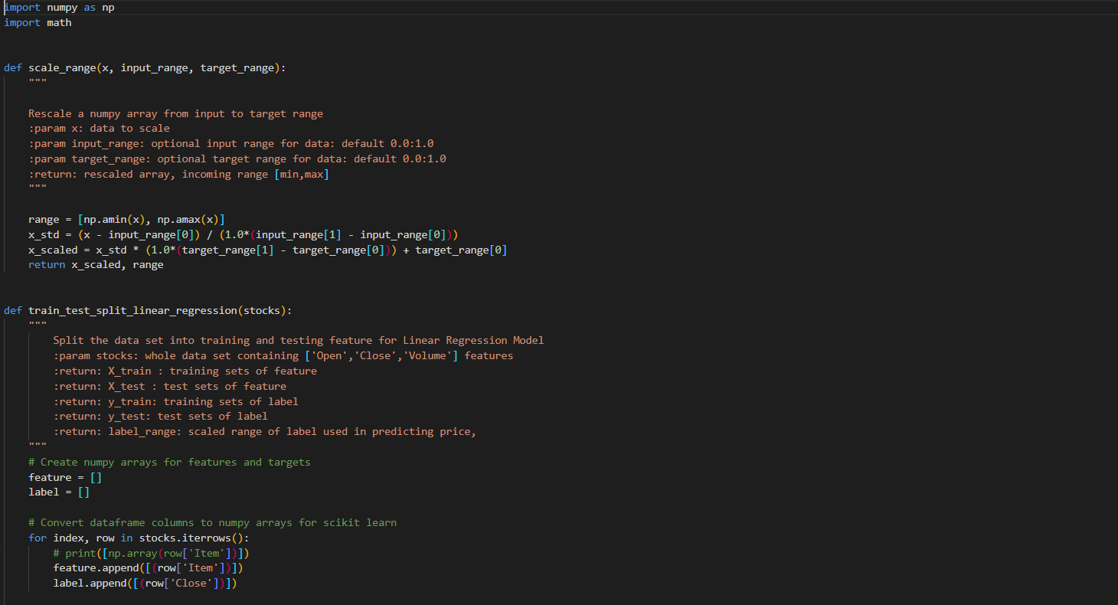
STOCK DATA FILE

Slide 24
RESULTS

Slide 25
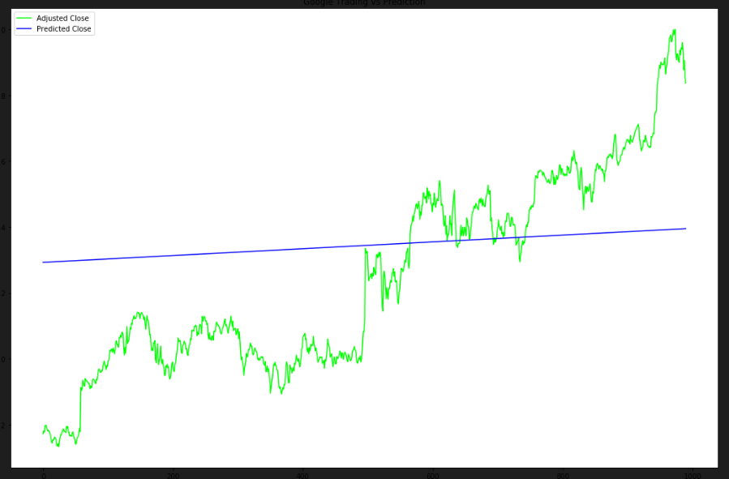
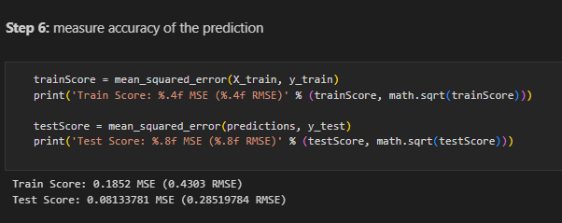
Measure accuracy of the Linear Regression Model

Slide 26
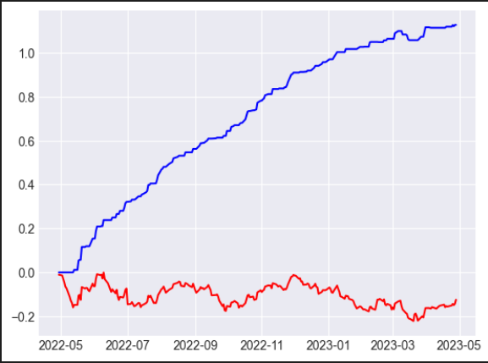
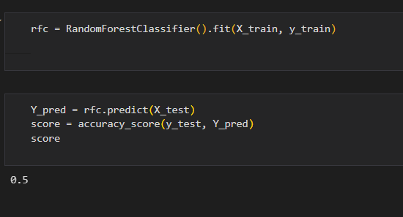
Measure the accuracy of Random Forest Model

Slide 27
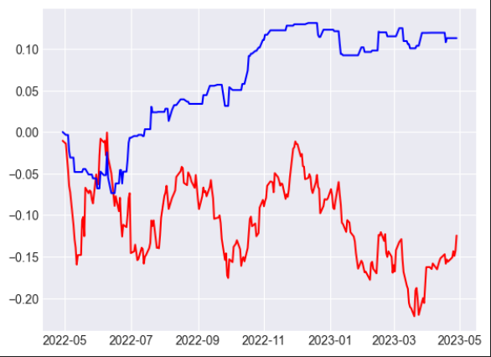
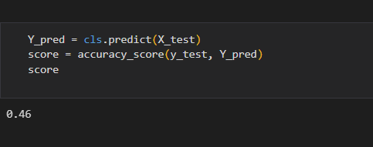
Measure the accuracy of SVM(support vector machine)

Slide 28
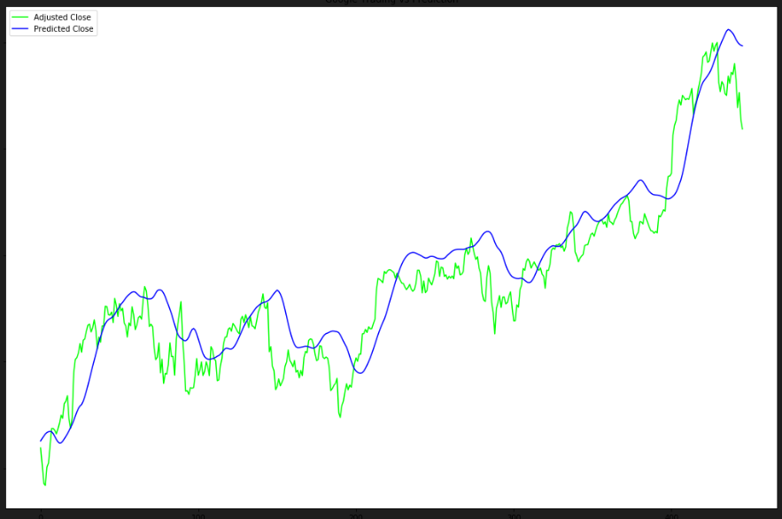
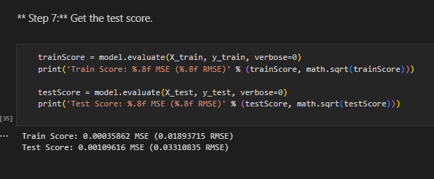
Measure accuracy of the LSTM(Long-short term memory) Model

Slide 29
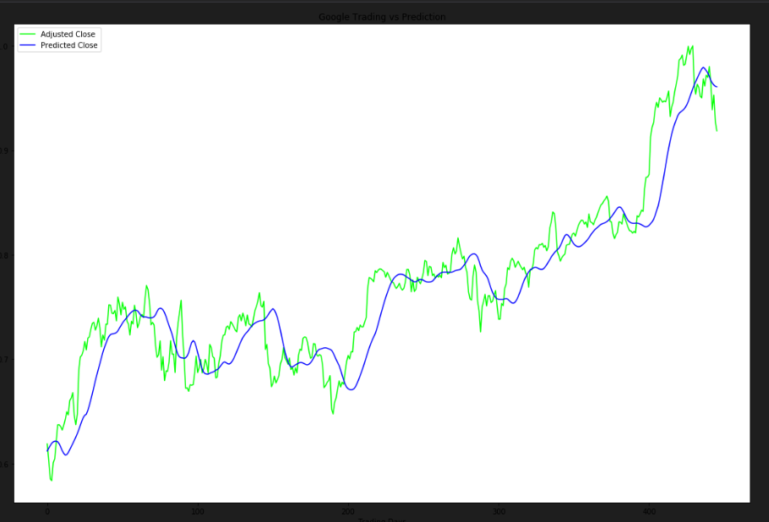
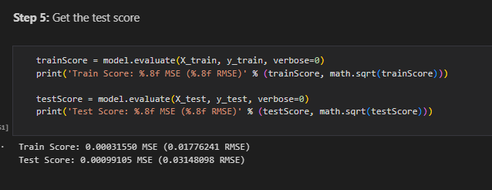
Measure accuracy of the Improved LSTM((Long-short term memory) Model

Slide 30
CONCLUSION & FUTURE SCOPE
Predicting stock market returns is a challenging task due to consistently changing stock values which are dependent on multiple parameters which form complex patterns. The historical dataset available on company’s website consists of only few features like high, low, open, close, adjacent close value of stock prices, volume of shares traded etc., which are not sufficient enough. To obtain higher accuracy in the predicted price value new variables have been created using the existing variables. RNN is used for predicting the next day closing price of the stock and for a comparative analysis, RF is also implemented. The comparative analysis based on RMSE, MAPE and MBE values clearly indicate that RNN gives better prediction of stock prices as compared to RF. Results show that the best values obtained by RNN model gives RMSE, MAPE and MBE. For future work, deep learning models could be developed which consider financial news articles along with financial parameters such as a closing price, traded volume, profit and loss statements etc., for possibly better results. [10]

Slide 31
REQUIREMENT ANALYSIS (LINK OF SRS)
https://drive.google.com/drive/folders/1IvJIh3sQdN5kmku-IAGBUrbK1BgpCSzA?usp=share_link

Slide 32
REFERENCE
[1]. K. Tsai and J. Wang, "External technology sourcing and innovation performance in LMT sectors", Research Policy, vol. 38, no. 3, pp. 518-526, 2009.
[2]. K. Han and J. Kim, "Genetic quantum algorithm and its application to combinatorial optimization problem", Evolutionary Computation, 2000, vol. 2, pp. 1354-1360, 2000.
[3]. Atsalakis, G. S., Dimitrakakis, E. M., & Zopounidis, C. D. (2011). Elliott wave theory and neuro- fuzzy systems, in stock market prediction: The WASP system. Expert Systems with Applications, 38, 9196–9206
[4]. Olivier C., Blaise Pascal University: “Neural network modeling for stock movement prediction, state of art”. 2007
[5]. Leng, X. and Miller, H.-G. : “Input dimension reduction for load prediction based on support vector machines”, IEEE International Conference on Electric Utility Deregulation, Restructuring and Power Technologies (DRPT2004), 2004.
[6]. Chun C, Qinghua M, Shuqiang L.: “Research on Support Vector Regression in the Stock Market Prediction” ©Springer, Advances in Intelligent and Soft Computing Volume 148, , pp 607-612, 2012.
[7]. Guo Z., Wang H., Liu Q. : “Financial time series prediction using LPP and SVM optimized by PSO” © Springer, Soft Computing Methodologies and Applications , December 2012.

Slide 33
[8]. Tsibouris, G., & Zeidenberg, M. (1995). Testing the efficent markets hypothesis with gradient descent algorithms. In R A (Ed.), Neural networks in the capital markets.John Wiley and Sons.
[9]. Guresen, E., Kayakutlu, G., & Daim, T. U. (2011). Using artificial neural network models in stock market index prediction. Expert Systems with Applications, 38(8), 10389–10397.
[10]. Gupta, A. :“Stock market prediction using Hidden Markov Models”, IEEE Engineering and Systems (SCES), 2012 Students Conference on, pp.1-4, 2012.

Slide 34
THANK YOU

